Slide 1

Understanding Portfolio Risk Over Time

Slide 2
Learning Objectives
After completing this assignment, students will:
Understand measures of risk such as variance and standard deviation
Be able to describe the evolution of stock returns through time and make comparisons to the portfolio returns
Use returns and variance to select stocks to build a portfolio
Achieve familiarity with handling data in Excel, and learn to present results from raw data in a clean and easy-to-read format

Slide 3
Assignment
Download data on stock returns for 3 selected companies (Disney, IBM and Southwest Airlines) and a market index (the S&P 500).
Using Excel, rearrange the data in a clean and easy-to-work format.
Graph the series of returns for each company and the market index.
Calculate the average return and standard deviation for each stock and the market.
Assuming you invest an equal amount in each company, calculate the return for the overall portfolio.

Slide 4
Link to Query
https://wrds-www.wharton.upenn.edu/classroom/monthly-stock-returns/

Slide 5
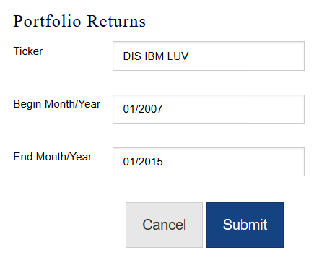

Query Parameters
Enter the company tickers.
Select 01/2007-01/2015 as the date range.
Click Submit.

Slide 6
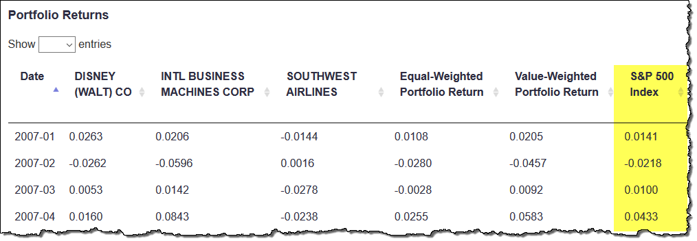
Query Results
The results also include monthly closing returns on the S&P 500 market index, from Jan. 2007 - Jan. 2015.

Slide 7
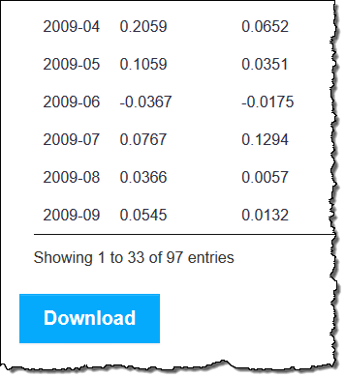
Query Results
Scroll to the bottom of the screen and click Download to download the data to Excel.

Slide 8
Assignment: Output
Once the data is downloaded, produce the following results:
Graph of the returns over time.
Calculate the average return and standard deviation for each company and the market index over the entire period.

Slide 9
Assignment: Output (cont.)
Assuming you invest an equal amount of wealth in each company, calculate the return of the portfolio.
Plot the returns of the portfolio over time.
Evaluate the variance/covariance matrix of the selected stocks.

Slide 10
Discussion Topics/Questions
Which stock has the highest/lowest return and in what month? How does the series of returns of the market look like? Which company performed the best and around what time? Which company the worst?
Which company had the highest volatility? Which one the lowest? Do they also have higher/lower returns than the others? How does the market behave with respect to the other companies?

Slide 11
Discussion Topics/Questions (cont.)
What is the return of the overall portfolio? How does it behave over time?
How does the portfolio return change by changing the proportion of investment in each stock?

